Slide 1
HUMAN RECOGNITION ACTIVITY
Trung Ngo –
Coderschool MLE 08/2021

Slide 2
TABLE OF CONTENTS
01
02
03
What is Human Activity Recognition (HAR) & Goals
DEMO Use-case…
Solution & Approach to model
?
04
Q&A

Slide 3
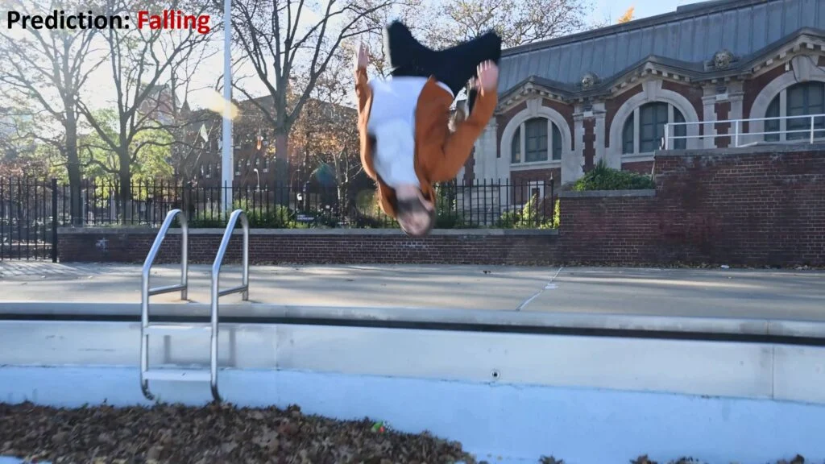
Understanding Human Activity Recognition
A person doing a backflip
An extracted frame – model predicts image as falling
Notes:
Before diving any deeper, let us first understand what Human Activity Recognition is.
To put it simply, the task of classifying or predicting the action being performed by someone is called Activity recognition.
Take a look at this backflip action done by this person, we can only tell it is a backflip by watching the full video on the left.
If a model sees only image on the right hand side, then it kind of looks like the person is falling so it predicts falling.
So Human Activity Recognition is a type of time series classification problem where you need data from a series of timesteps to correctly classify the action being performed.

Slide 4


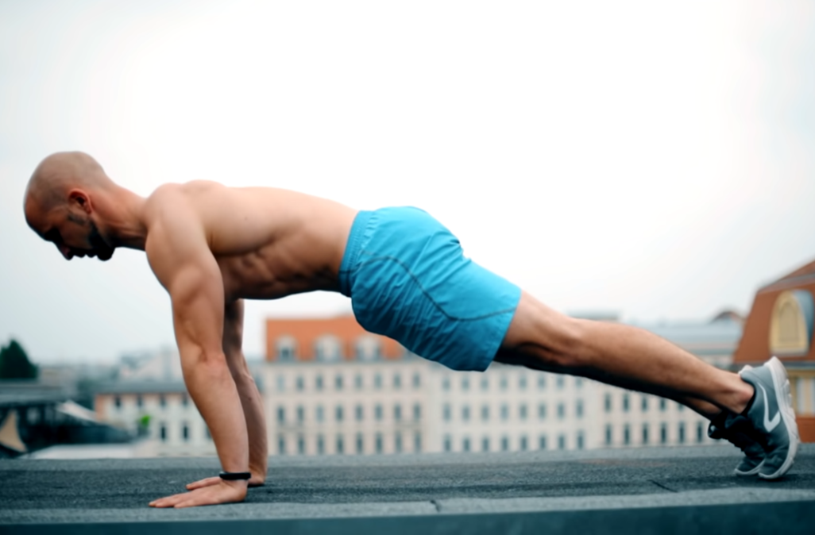
HAR – Predicting human activity based on time series data
Seen action (Input)
Unseen action (Output)
70%
20%
10%
Pull ups
Push up
Falling
Notes:
Human activity recognition (HAR) is one of the most important and challenging problems in the computer vision.
It has critical application in wide variety of tasks including sports, health monitoring, rehab, video surveillance, and robotics.
In this project what I do is to train 2 type of models with a set of recognized actions
Then during the demo I will choose a random video on youtube to test the performance of the model.

Slide 5
My journey
Develop CNN-LSTM model
Data processing
Week 02
Week 04
Week 01
Week 03
First approach using Single-Frame CNN
Fine-tuning Built Streamlit app
Notes:
Here is my project timeline and how I spent the last couple weeks on this project.
In my first week, I spent most of the time looking for dataset and procrastinate on the ideas around the subject.
I looked over a few dataset such as UCF11, UCF50, HMDB51, UCF101 but deciding to go with UCF 101.
In my second week, I gave the first attempt to use single frame CNN to model the problem.
Unsatisfied with the result so I moved on to develop a CNN-LSTM model to see if there is any improvement so in my third week, I developed a CNN-LSTM model.
The CNN LSTM or CNN Long Short-Term Memory Network for short is an LSTM architecture designed for sequence prediction problems with spatial inputs, like images or videos.
This architecture has also been used on other problem such as speech recognition and natural language processing where CNNs are used as feature extractors for the LSTMs on audio and textual input data.

Slide 6
(8 subclasses)
Applying Makeup
Boxing
Lecturing
Marching
Playing Golf
Pull ups
Push ups
Weightlifting
Source: UCF 101
200-250 videos per class
3s-12s per video
Resized input frames to (64x64x3)
Data processing
VGG16+LSTM
Week 02
Week 04
Week 01
Week 03
Single-Frame CNN
Fine-tuning Streamlit
Notes:
For the training, I used the UCF101 dataset, you can check out the source in my reference
but UCF101 dataset has 101 classes and it will take a very long time to train
so I decided to only use 8 subclasses as above.
Every class contains roughly 200-250 videos , each of 30 fps, roughly 3s-12s per video
I also resized img_height and img_weight, for each extracted frame of videos before inputting to these models.
There is another factor that greatly influences the performance is the number of frames extracted per videos.
After many trial and errors I decided to use max 70 frames per videos, this can be increase for better results but higher than this figure is computationally intensive and crash my GPU.

Slide 7
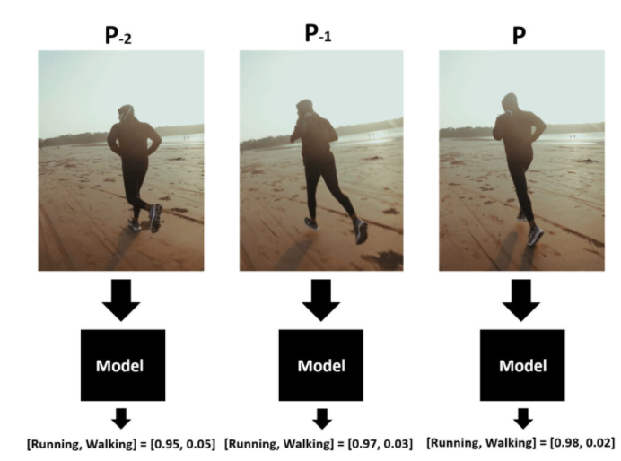
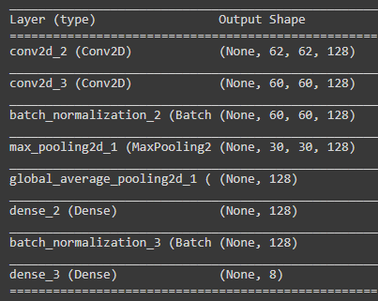
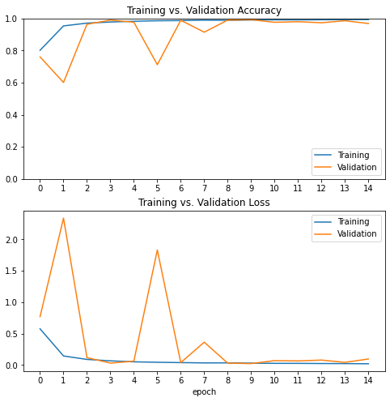
Model Architecture
Accuracy
Averaging
Loss
Data processing
VGG16+LSTM
Week 02
Week 04
Week 01
Week 03
Single-Frame CNN
Fine-tuning Streamlit
Notes:
In my first attempt, I use a single-frame CNN model. On the left hand size is the model architecture, the right hand size is the training accuracy and loss.
The approach is similar to a normal image classification problem.
In this case , I ran an image classification model on every single frame of the video and then average all the probabilities to get the final probabilities of the entire video.
Also, it is worth mentioning here is that videos generally contain a lot of frames,
and we do not need to run a classification model on each frame, but only a few of them that are spread out throughout the entire video.
In my demo, I only use max 100 frames for the prediction.
----------------------------------------------------------
Now there is a drawback with this approach. The issue is that the model will not always be fully confident about each video frame’s prediction, the predictions will change rapidly and fluctuate.
Also, Depending on the model to learn environmental context instead of the action sequence, it could overfit and predict is terribly wrong.
This is also the reason the approaches above will not work well when the actions are similar.
Consider the action of Standing Up from a Chair and Sitting Down on a Chair. In both actions, the frames are almost the same. The main differentiator is the order of the frame sequence. So you need temporal information to correctly predict these actions.

Slide 8
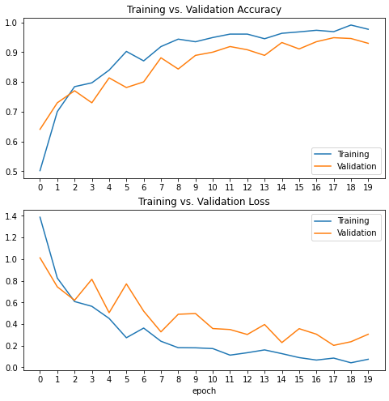
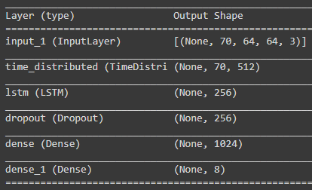
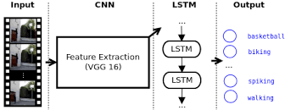
Model Architecture
Data processing
VGG16+LSTM
Week 02
Week 04
Week 01
Week 03
Single-Frame CNN
Fine-tuning Streamlit
Notes:
In my next attempt, I use LSTM model , a type of recurrent neural network model.
And coupling it with a convolutional neural network to enhance performance
The idea in this approach is to use VGG 16 to extract local features of each frame on the input data, transforming it from input pixels into an internal matrix
The outputs of VGG16 then fed to a multilayer LSTM network to extract information temporarily.
IN my model, the CNN is not trained. It acts more like an image interpretation for my LSTM model.
I achieved a very high accuracy on both training and validation set (~92% on validation and ~97% on training set)
Maybe worth pointing out here is the input of CNN LSTM model is 5D tensor compared to the CNN model is 4D tensor

Slide 9
Sensitivity Analysis:
Dropout rate (20%-40%)
Numbers of layers
Batch size (16-64)
Data processing
VGG16+LSTM
Week 02
Week 04
Week 01
Week 03
Single-Frame CNN
Fine-tuning Streamlit
Notes:
Recognizing human activities from video sequences is a challenging task due to problems, such as background light, viewpoint, details in frames and appearance….etc

Slide 10
Demo

Slide 11
Where it goes from here….
Comparing performance between different sequence models (bidirectional, fusion…)
Training with better GPU.
Apply filter noise (such as background…)
Monitor & continue to improve model
Streamline product for publishing

Slide 12
RESOURCES
Papers
https://learnopencv.com/introduction-to-video-classification-and-human-activity-recognition/Dashboard element collection
https://thebinarynotes.com/video-classification-keras-convlstm/Dashboard element collection template
Dataset
UCF101 …. Check out the link here

Slide 13
?

Slide 14


